Slide 1

Journey Presentation WEEK 6
Anisha Gupta (Batch- 4)

Slide 2
CUSTOM TRAINING

Slide 3

DAY 14: 19-09-2023
Arguments :
Positional Arguments -> def fun(a,b,c) → same position → order is very important
Keyword Arguments → def fun(a=1, b=2, c=3)
Default arguments → if value of third parameter not provided then replace with the default value
Variable Length arguments
Introduction to pandas dataframe
Gained knowledge on list functions and lambda functions

Slide 4
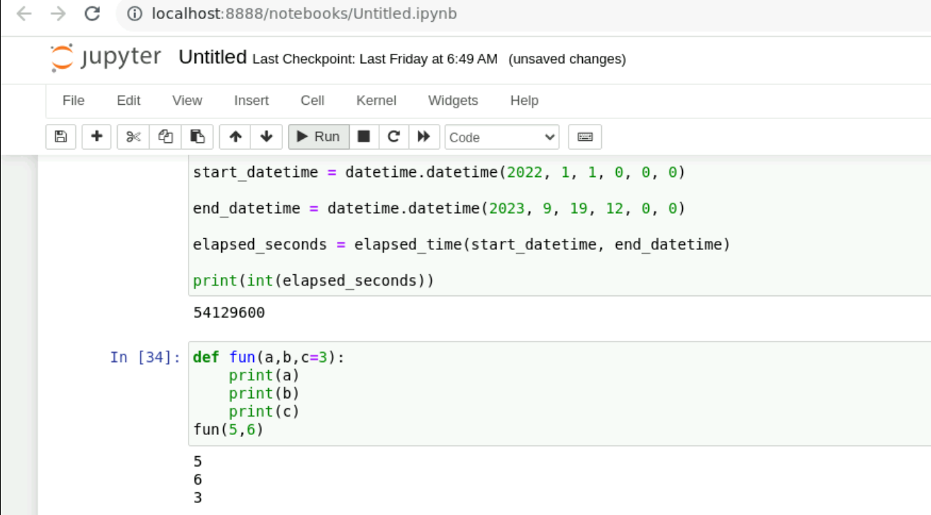
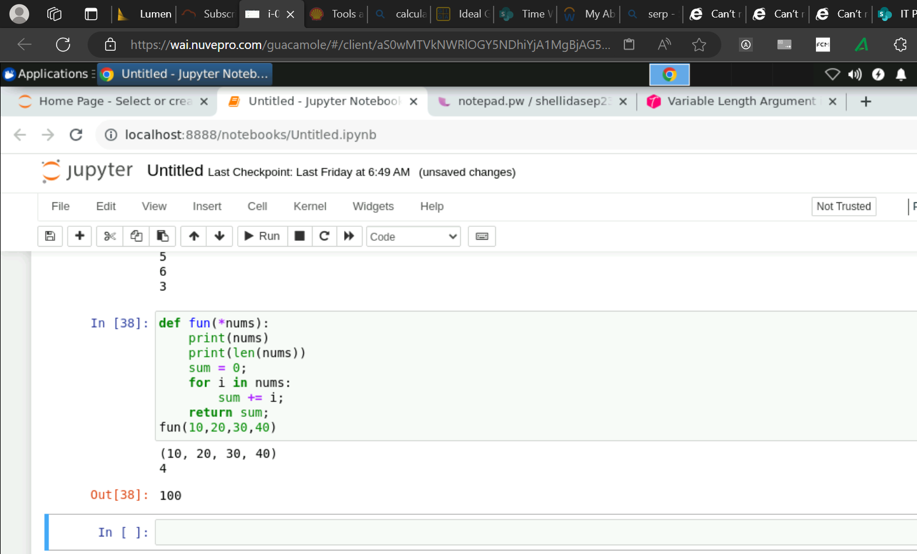
Working with Python Functions and experimenting various argument types

Slide 5
DAY 15: 20-09-2023
Introduction to Panda Dataframe, Series, Lists, Dictionaries, Sets, Tuples, etc.
Parameters:
filepath_or_buffer: Location of the csv file. It accepts any string path or URL of the file.
sep: It stands for separator, default is ‘, ‘.
header: It accepts int, a list of int, row numbers to use as the column names, and the start of the data. If no names are passed, i.e., header=None, then, it will display the first column as 0, the second as 1, and so on.
usecols: Retrieves only selected columns from the CSV file.
nrows: Number of rows to be displayed from the dataset.
index_col: If None, there are no index numbers displayed along with records.
skiprows: Skips passed rows in the new data frame.

Slide 6
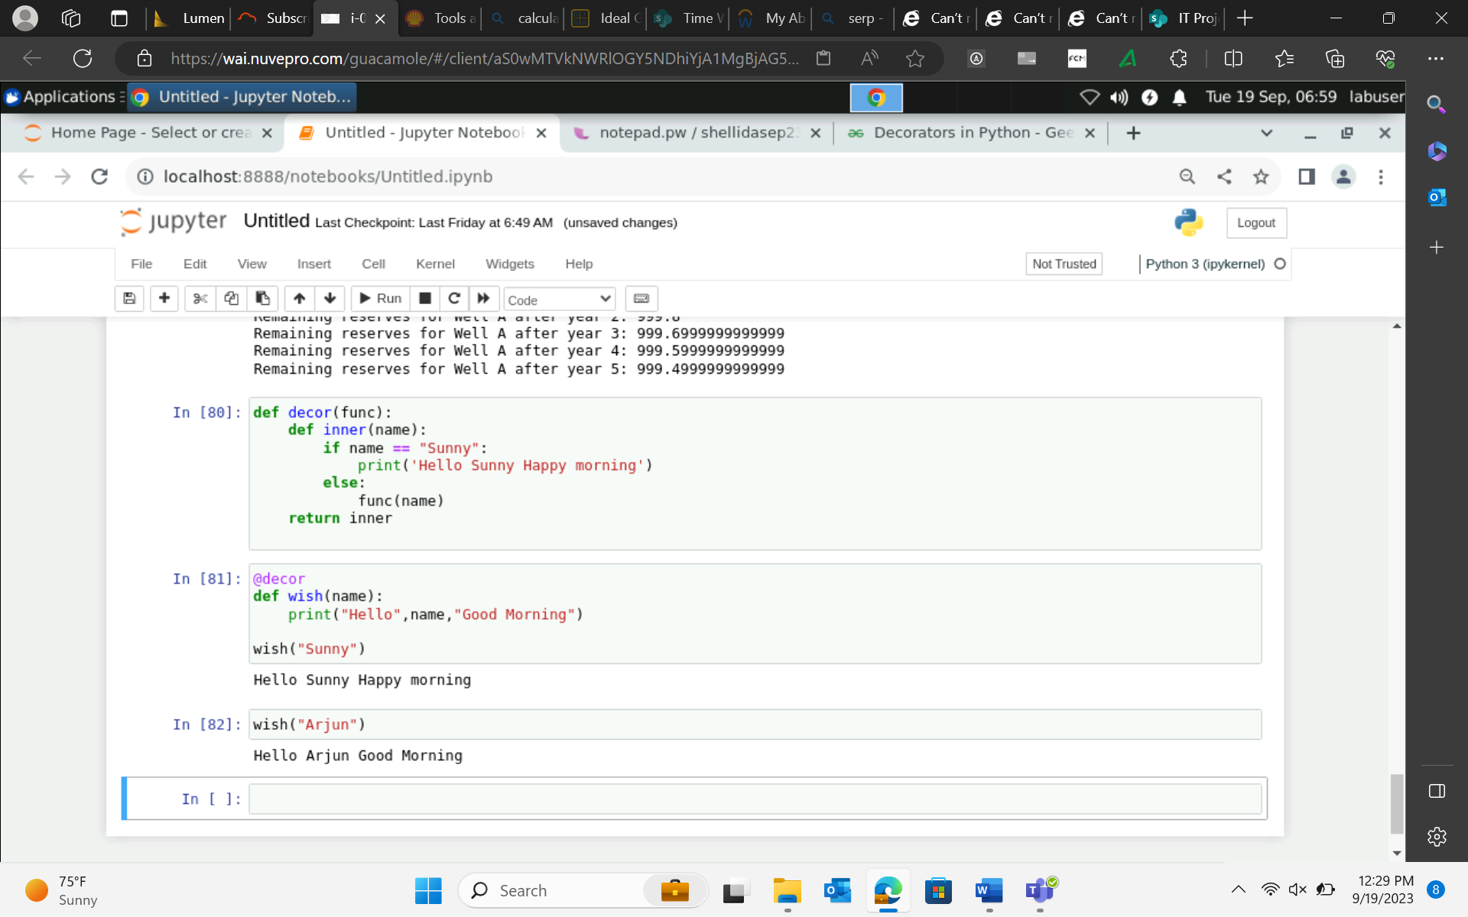
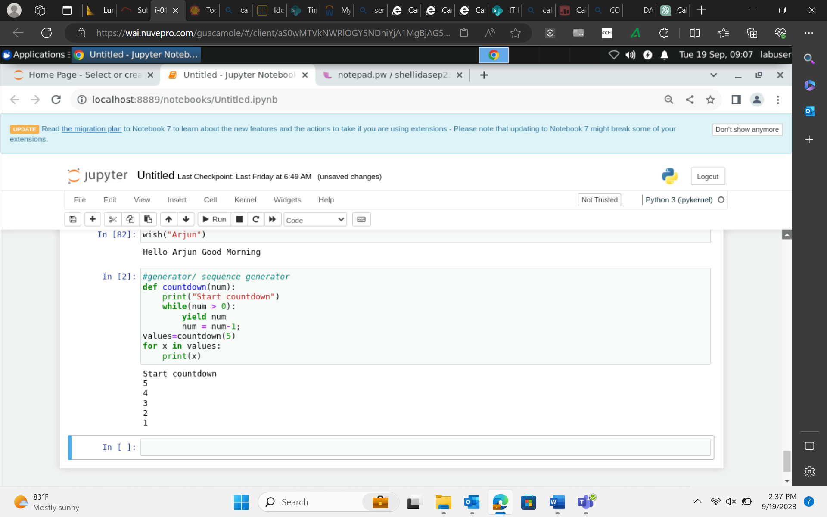
Decorator Python Function
Python Sequence Generator

Slide 7
DAY 16: 21-09-2023
Introduction to Pyspark
Transformations:
Flatmap(), distinct(), filter(), dropDuplicates(), select()
Actions:
Show(), Collect(), Count()
Process:
Flatmap: Line → Word
Map: Word, 1 [NARROW TRANSFORMATION]
reduceByKey: word, count [WIDE TRANSFORMATION]
counts.collect()

Slide 8
DAY 16: 21-09-2023
Spark Components:
Job
Stages
Partitions (in workers memory)
Tasks (each partition has 1 task to be executed)
Executors (Every task is executed by 1 executor)
Master (Driver)
Worker (Executes the actual task)
Spark Context (sc)- Entrypoint and Spark Session (spark)
Data Ingestion:
Inferschema
Header
Sep/ delimiter ➔ option(“sep”,”|”).csv
User defined schema ➔ structType, structfield → use as schema(EmpSchema)

Slide 9
DAY 16: 21-09-2023
Data Cleansing and Scrubbing:
How to handle bad records:
Mode → permissive → replaces mismatched values with null
Dropmalformed → drops all the corrupted data
Failfast → sensitive data→ throws exception
Duplicate values:
Distinct(): entire df
dropDuplicates(): for particular columns
Filter:
Row filter → use where condition or filter
Column filter → select()
Writing new file:
Parquet file format: compressed file format (default file format in spark)

Slide 10
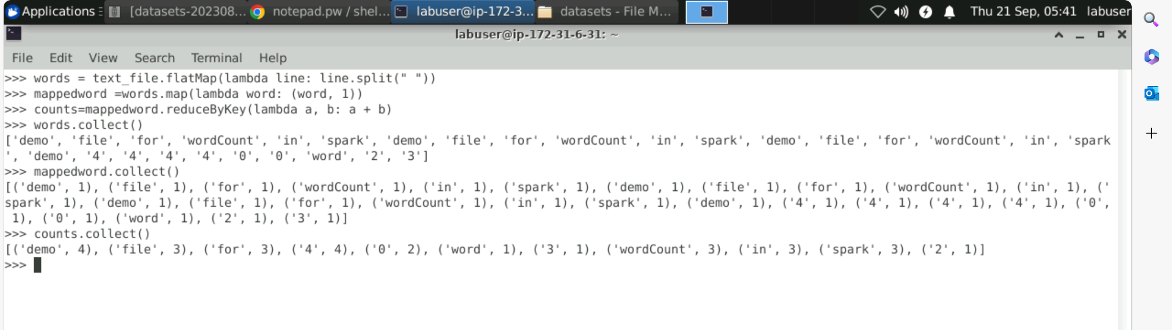
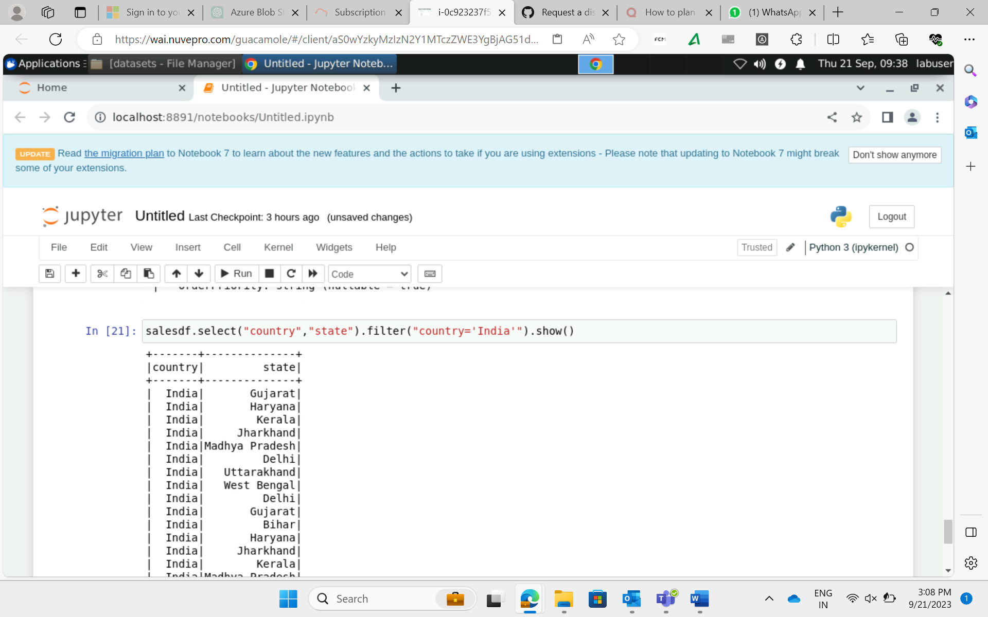
Simple wordcount code in Pyspark
Using Filter in PySpark code

Slide 11
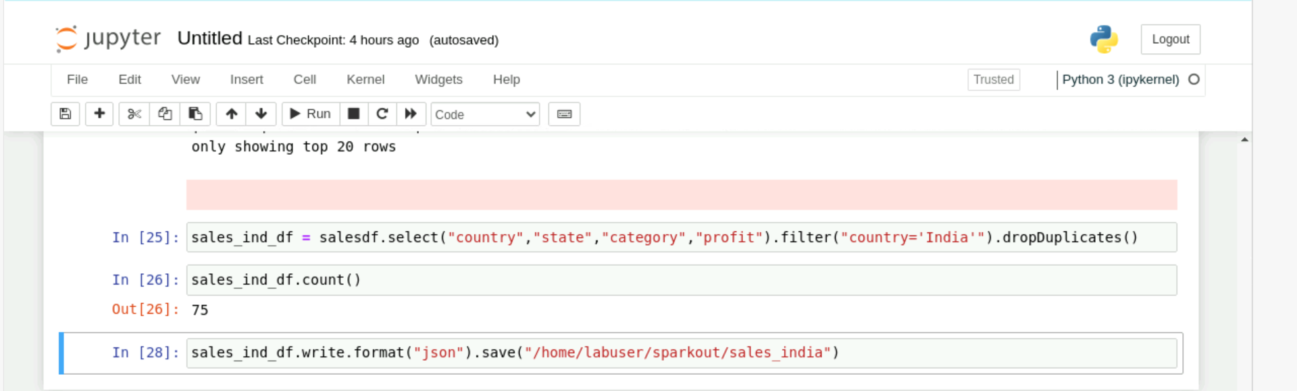
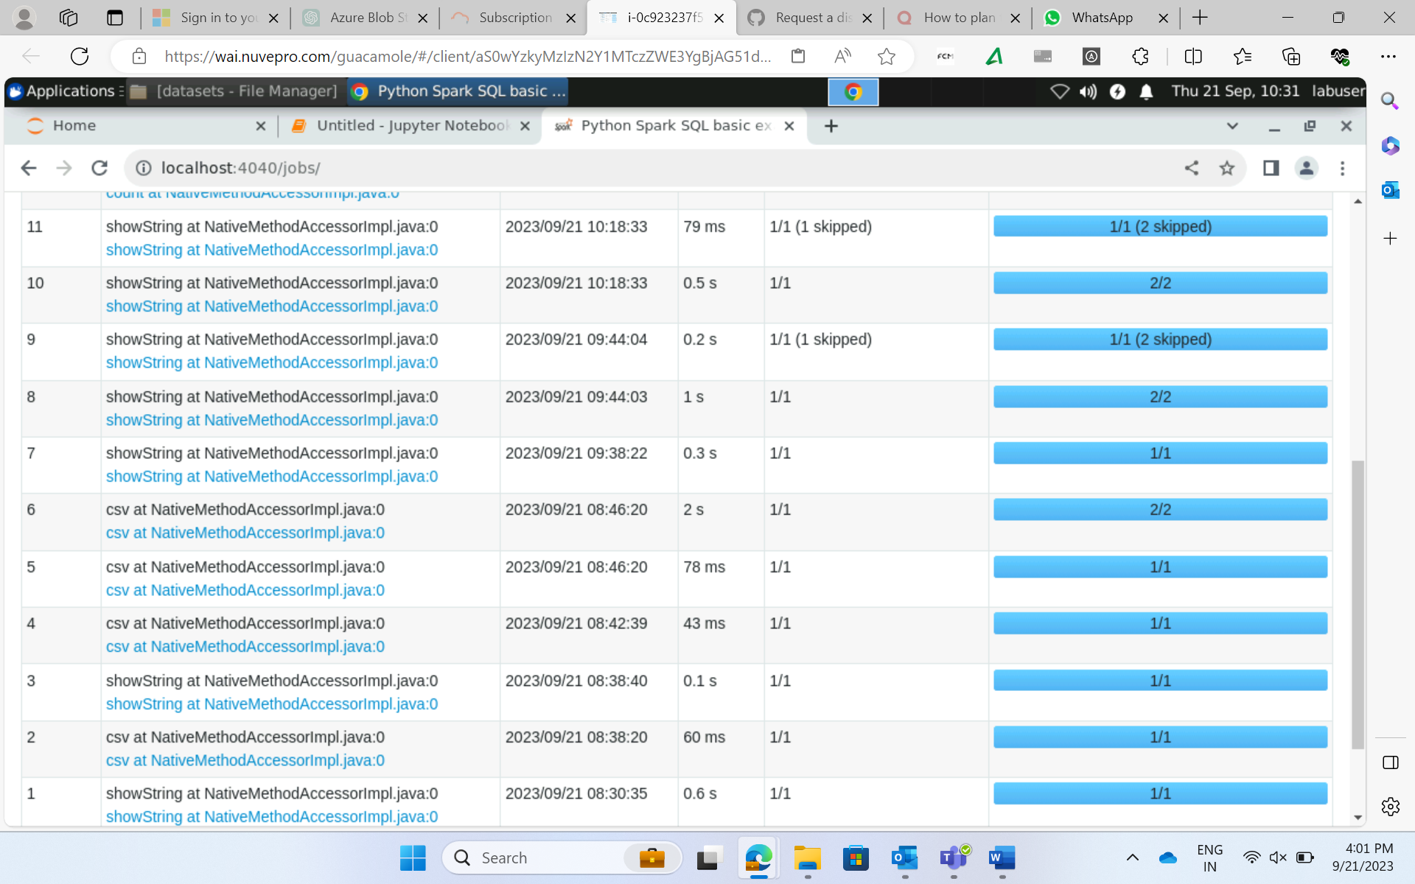
Writing new file in json format
Jobs performed in PySpark

Slide 12
DAY 17: 22-09-2023
Wrote Word Count Program: Using spark-submit command
Learnt to handle parallelism in Spark – using reparallelism and coalesce
Caching in PySpark
Storage levels
Join types in PySpark

Slide 13
